Slide 1


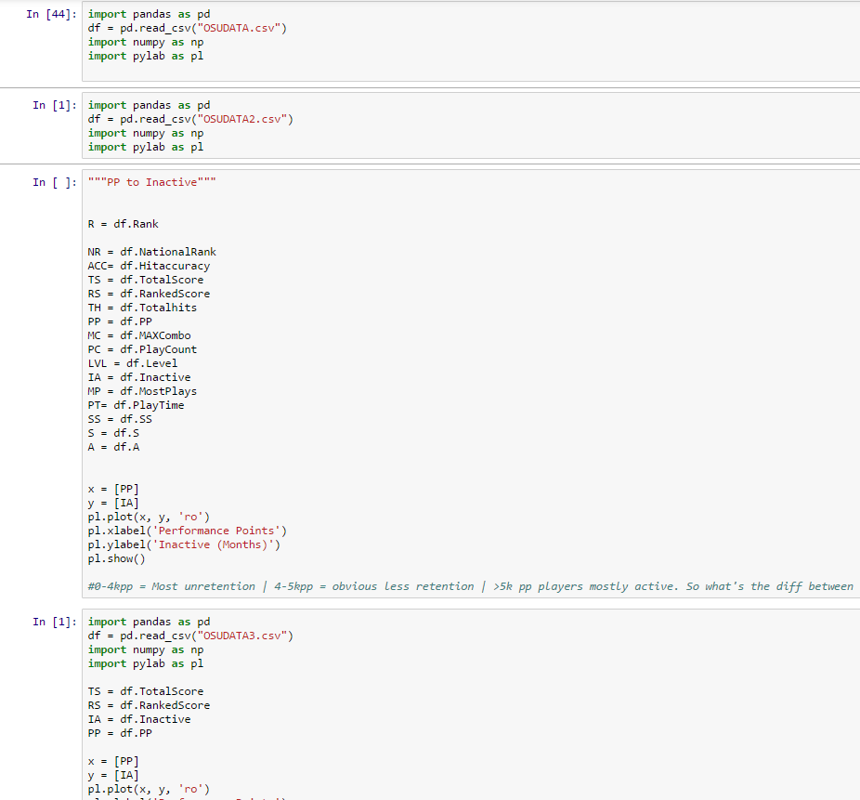
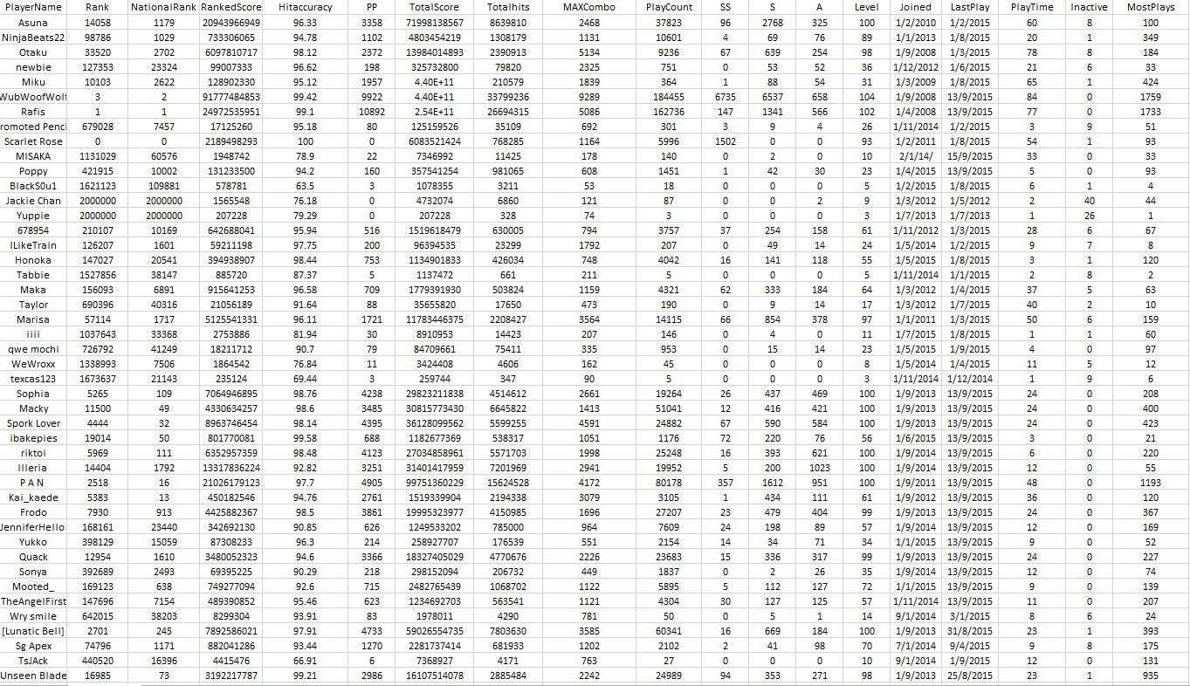
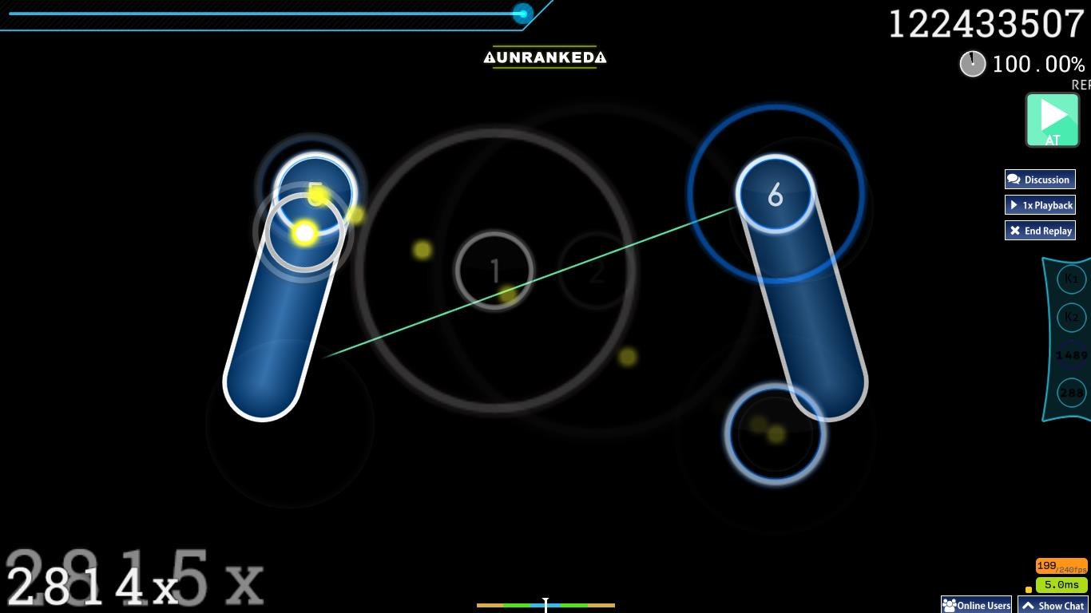
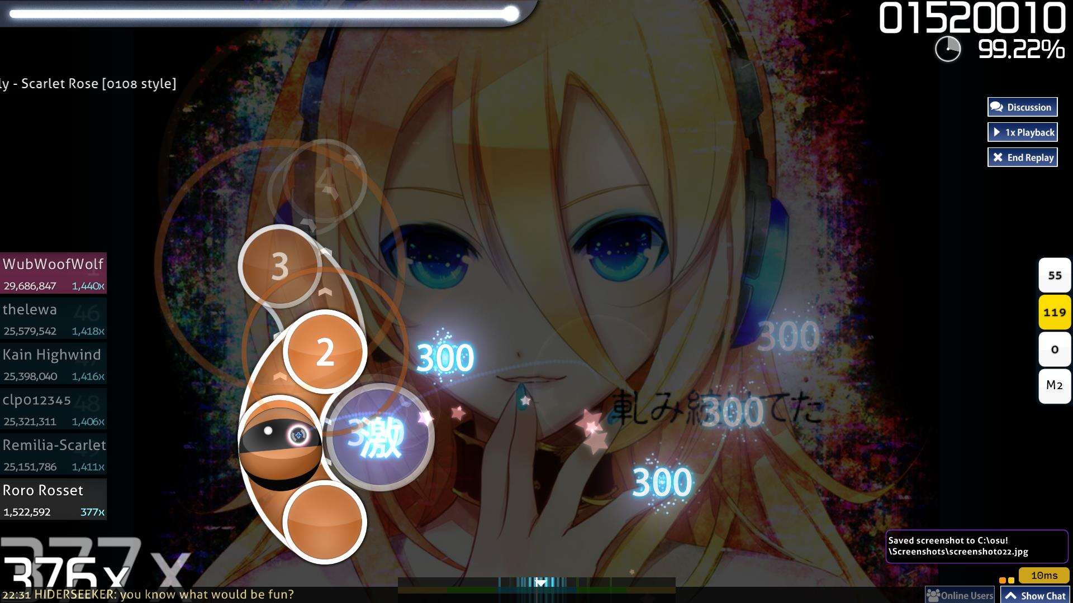

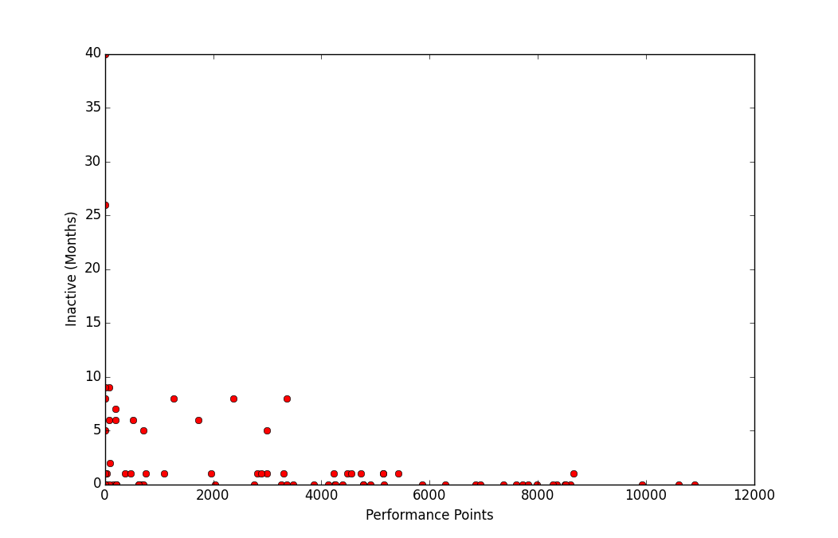
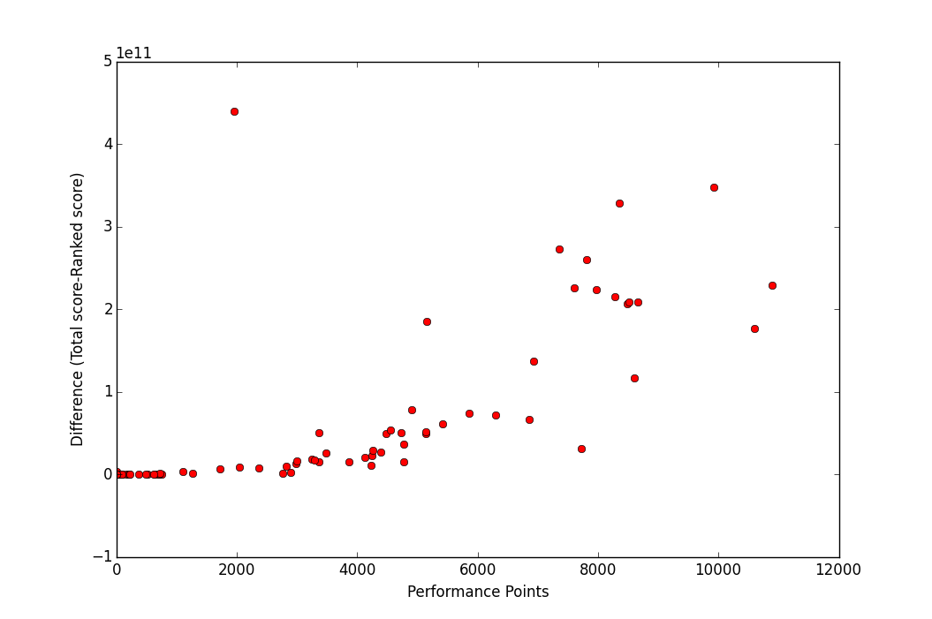
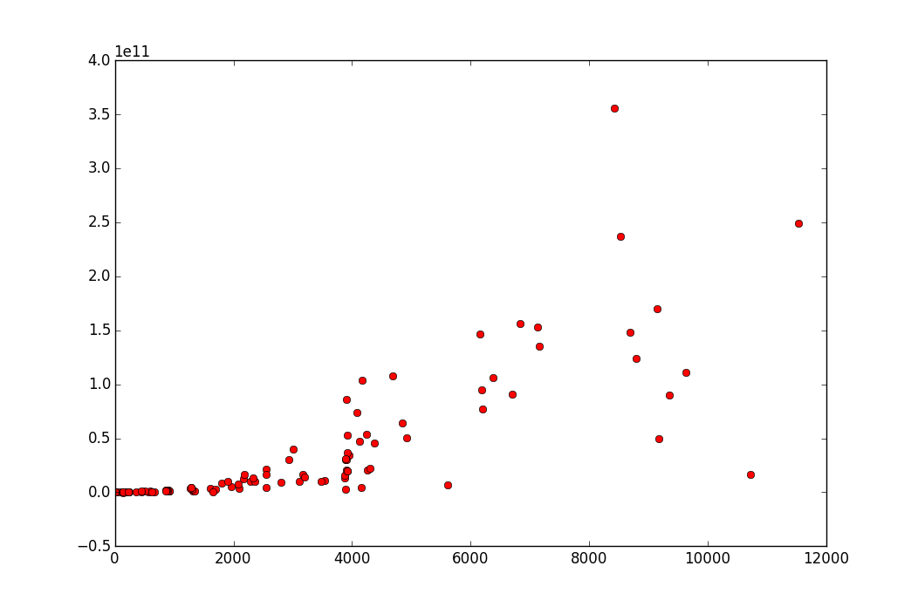
NCHS-NYP Science and Technology Symposium 2016
NCHS7 - Game Analytics
Done by: Nicholas Yek, Tan Yi Xiang, Shaun Tan, Lew Xuan Ming
Research Mentors: Mr Sim Tze Jan, Mr Alvin Sebastian Teacher Mentor: Ms Chney Chen Xiao Wei
I Introduction
II Investigation & Analysis
What is game analytics?
-The collection of relevant data from a game and utilising it to understand player behaviour and hypothesize possible improvements from the sections with areas for improvement using statistics based research.
-Data Mining of Games to improve the experience of players. That is the crux of game analytics.
--It’s not game analysis: playing a game and judging it based on your own opinion.
---In Game Analytics we look at the facts, raw data on the actions of every single player in your game. How often do they play your game? How long is each play session? Those are the questions that game analytics can answer.
Our target: Osu! – A popular rhythm game with a
large player base reaching 1+ million!
Our hypothesis: Player retention would more likely occur if a player had certain characteristics and that players would quit or play less due to the extensive difficulty curve in Osu!
By collecting data from Osu!, we can use that data using software (IPython) to visualise the data and find out what traits these active players have that the others don’t.
We gathered data from Osu! as they provided scores of player data for free on their webpage.
We then narrowed down the important variables: (i) PP (‘performance points’ the amount of skill one has based on Osu!’s unique algorithm) (ii) Total Score (the total score of unranked and ranked plays, offline and online) (iii) Ranked Score (the total score obtained from ranked plays) and (iv) Difference (Total score – Ranked Score) (iv) Inactive (the time that a player has been inactive, in terms of months)
We did a collection of a new sample of 100 players of all skill groups to ensure fairness and consistency.
< Our code in IPython Notebook to analyse the data
A part of the data we have collected
III CONCLUSION
4. This graph shows Inactive against PP.
-We can see that players above 5000PP played regularly with 0 months inactive (rounded off). The more PP a player has, the more likely the player is active.
--This showed that continuous play is a factor in the skill of a player.
---5000PP will be the factor we will be looking at for later graphs
a) Patient and persistent players are more likely to pass the 5000PP threshold and hence, be more proficient in Osu!
b)Osu! should work towards assisting players to reach 5000pp for better retention rates. Based on the statistics, the players with more patience and practice were more likely to reach the score threshold and remain more active.
c)We suggest Osu! Implement a purely for practice checkpoint system to help assist all players to pass through songs with tight chokepoints
5. This graph shows Difference (DIFF) against PP. From the graph, we can see that players with 0.5x10^11 DIFF are the common trait of players whom are >5000 PP. These players who play more unranked maps and practiced more on ranked maps have more performance points and thus have a higher skill compared to someone who has a lower DIFF.
Same variable comparison with the 3rd data collection.
Acknowledgements
Thank you teacher mentor, Miss Chney Chen and our research mentors: Mr Alvin Sebastian and Mr Sim Tze Jan as they have assisted greatly in our project in the form of constructive criticism and guidance when we were unsure about the project, especially during the initial stages when we were trying to tackle the problem of a platform for game analytics to shine. We would also like to thank Mr Tan and Mdm Chow, our principal and vice-principal for supporting this program and allowing us this opportunity to develop ourselves as students.

